Slide 1
How Tableau taught me JavaScript – Combining tools & technologies to make your imagination come to life.
Thomas Rones oh22data AG
@thomasrones

Slide 2
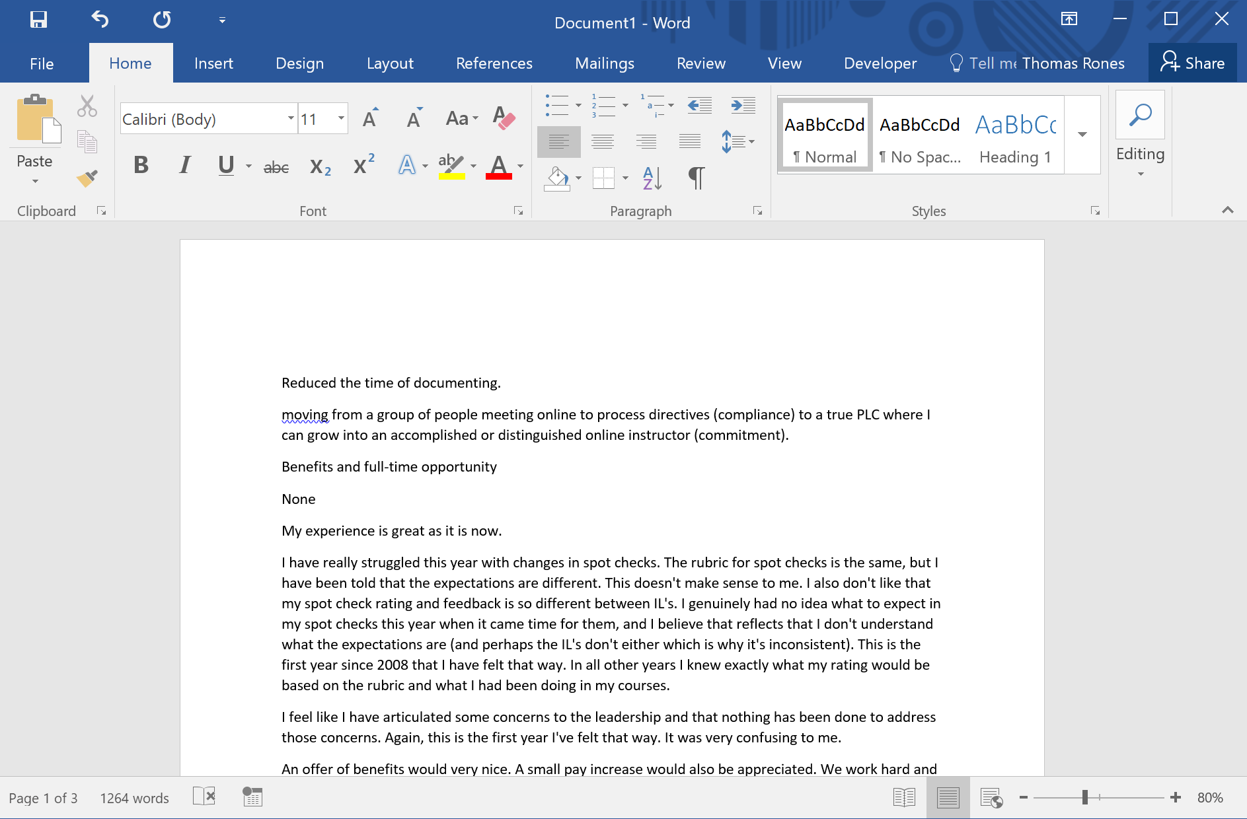

Slide 3
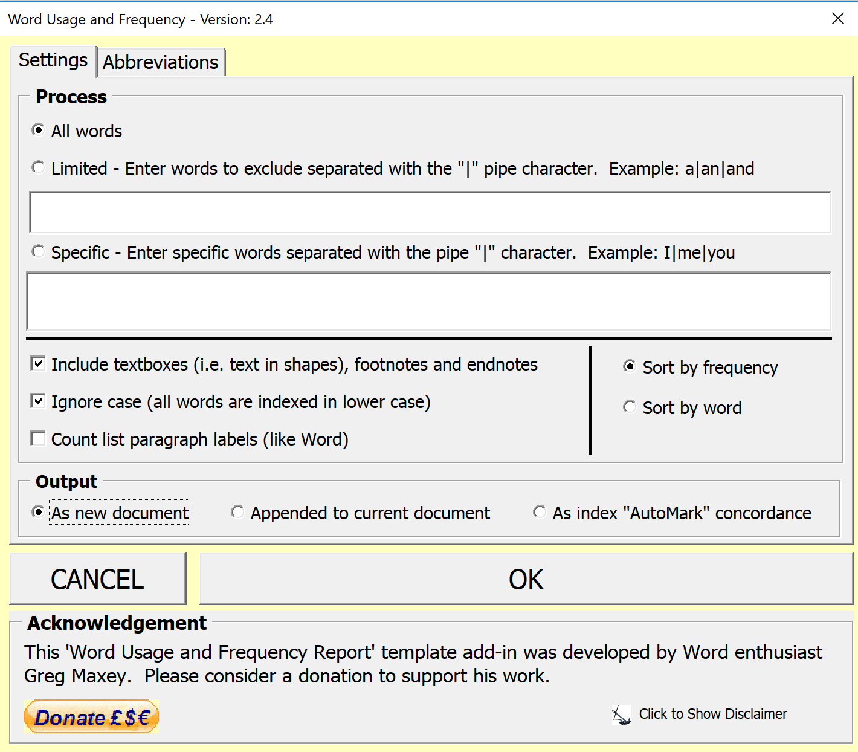

Slide 4
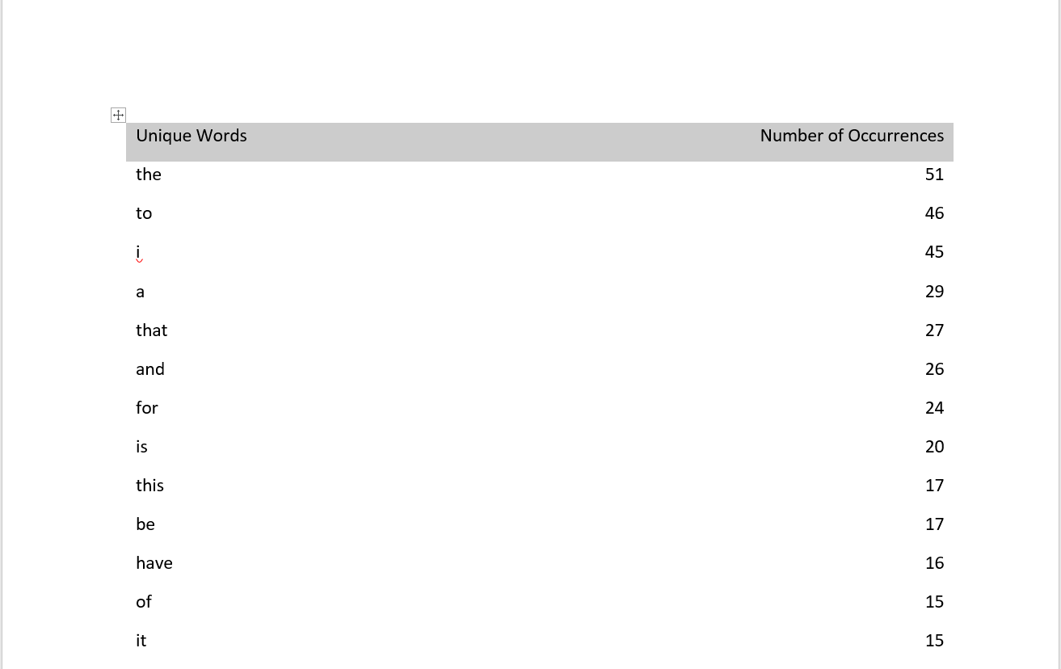

Slide 5
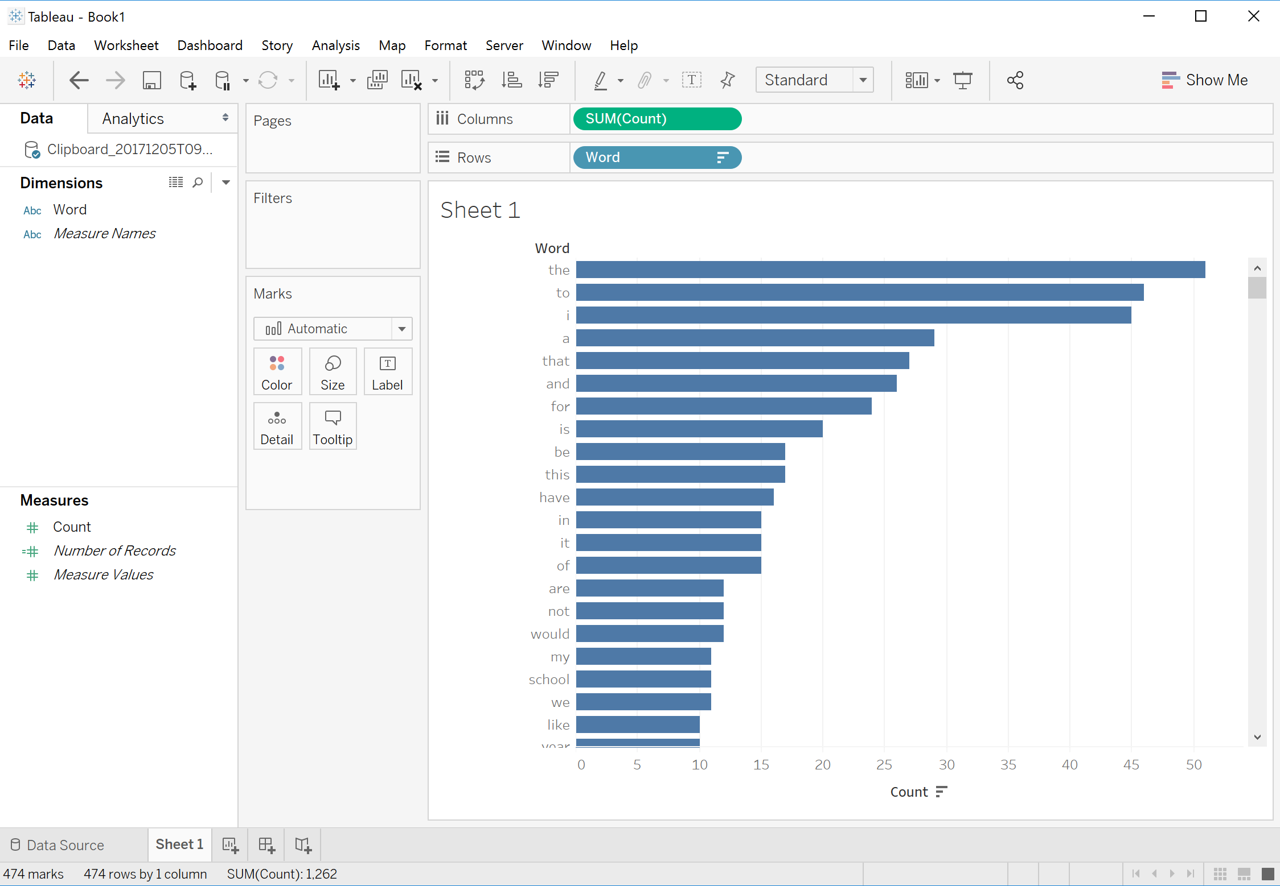
Tableau dashboard with only bar chart

Slide 6
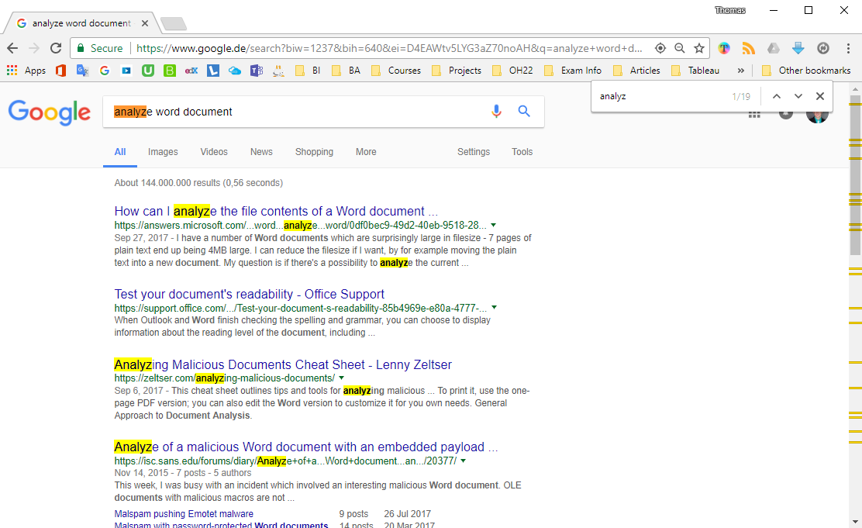

Slide 7
Step 1:
Get my webpage to show up in my dashboard

Slide 8
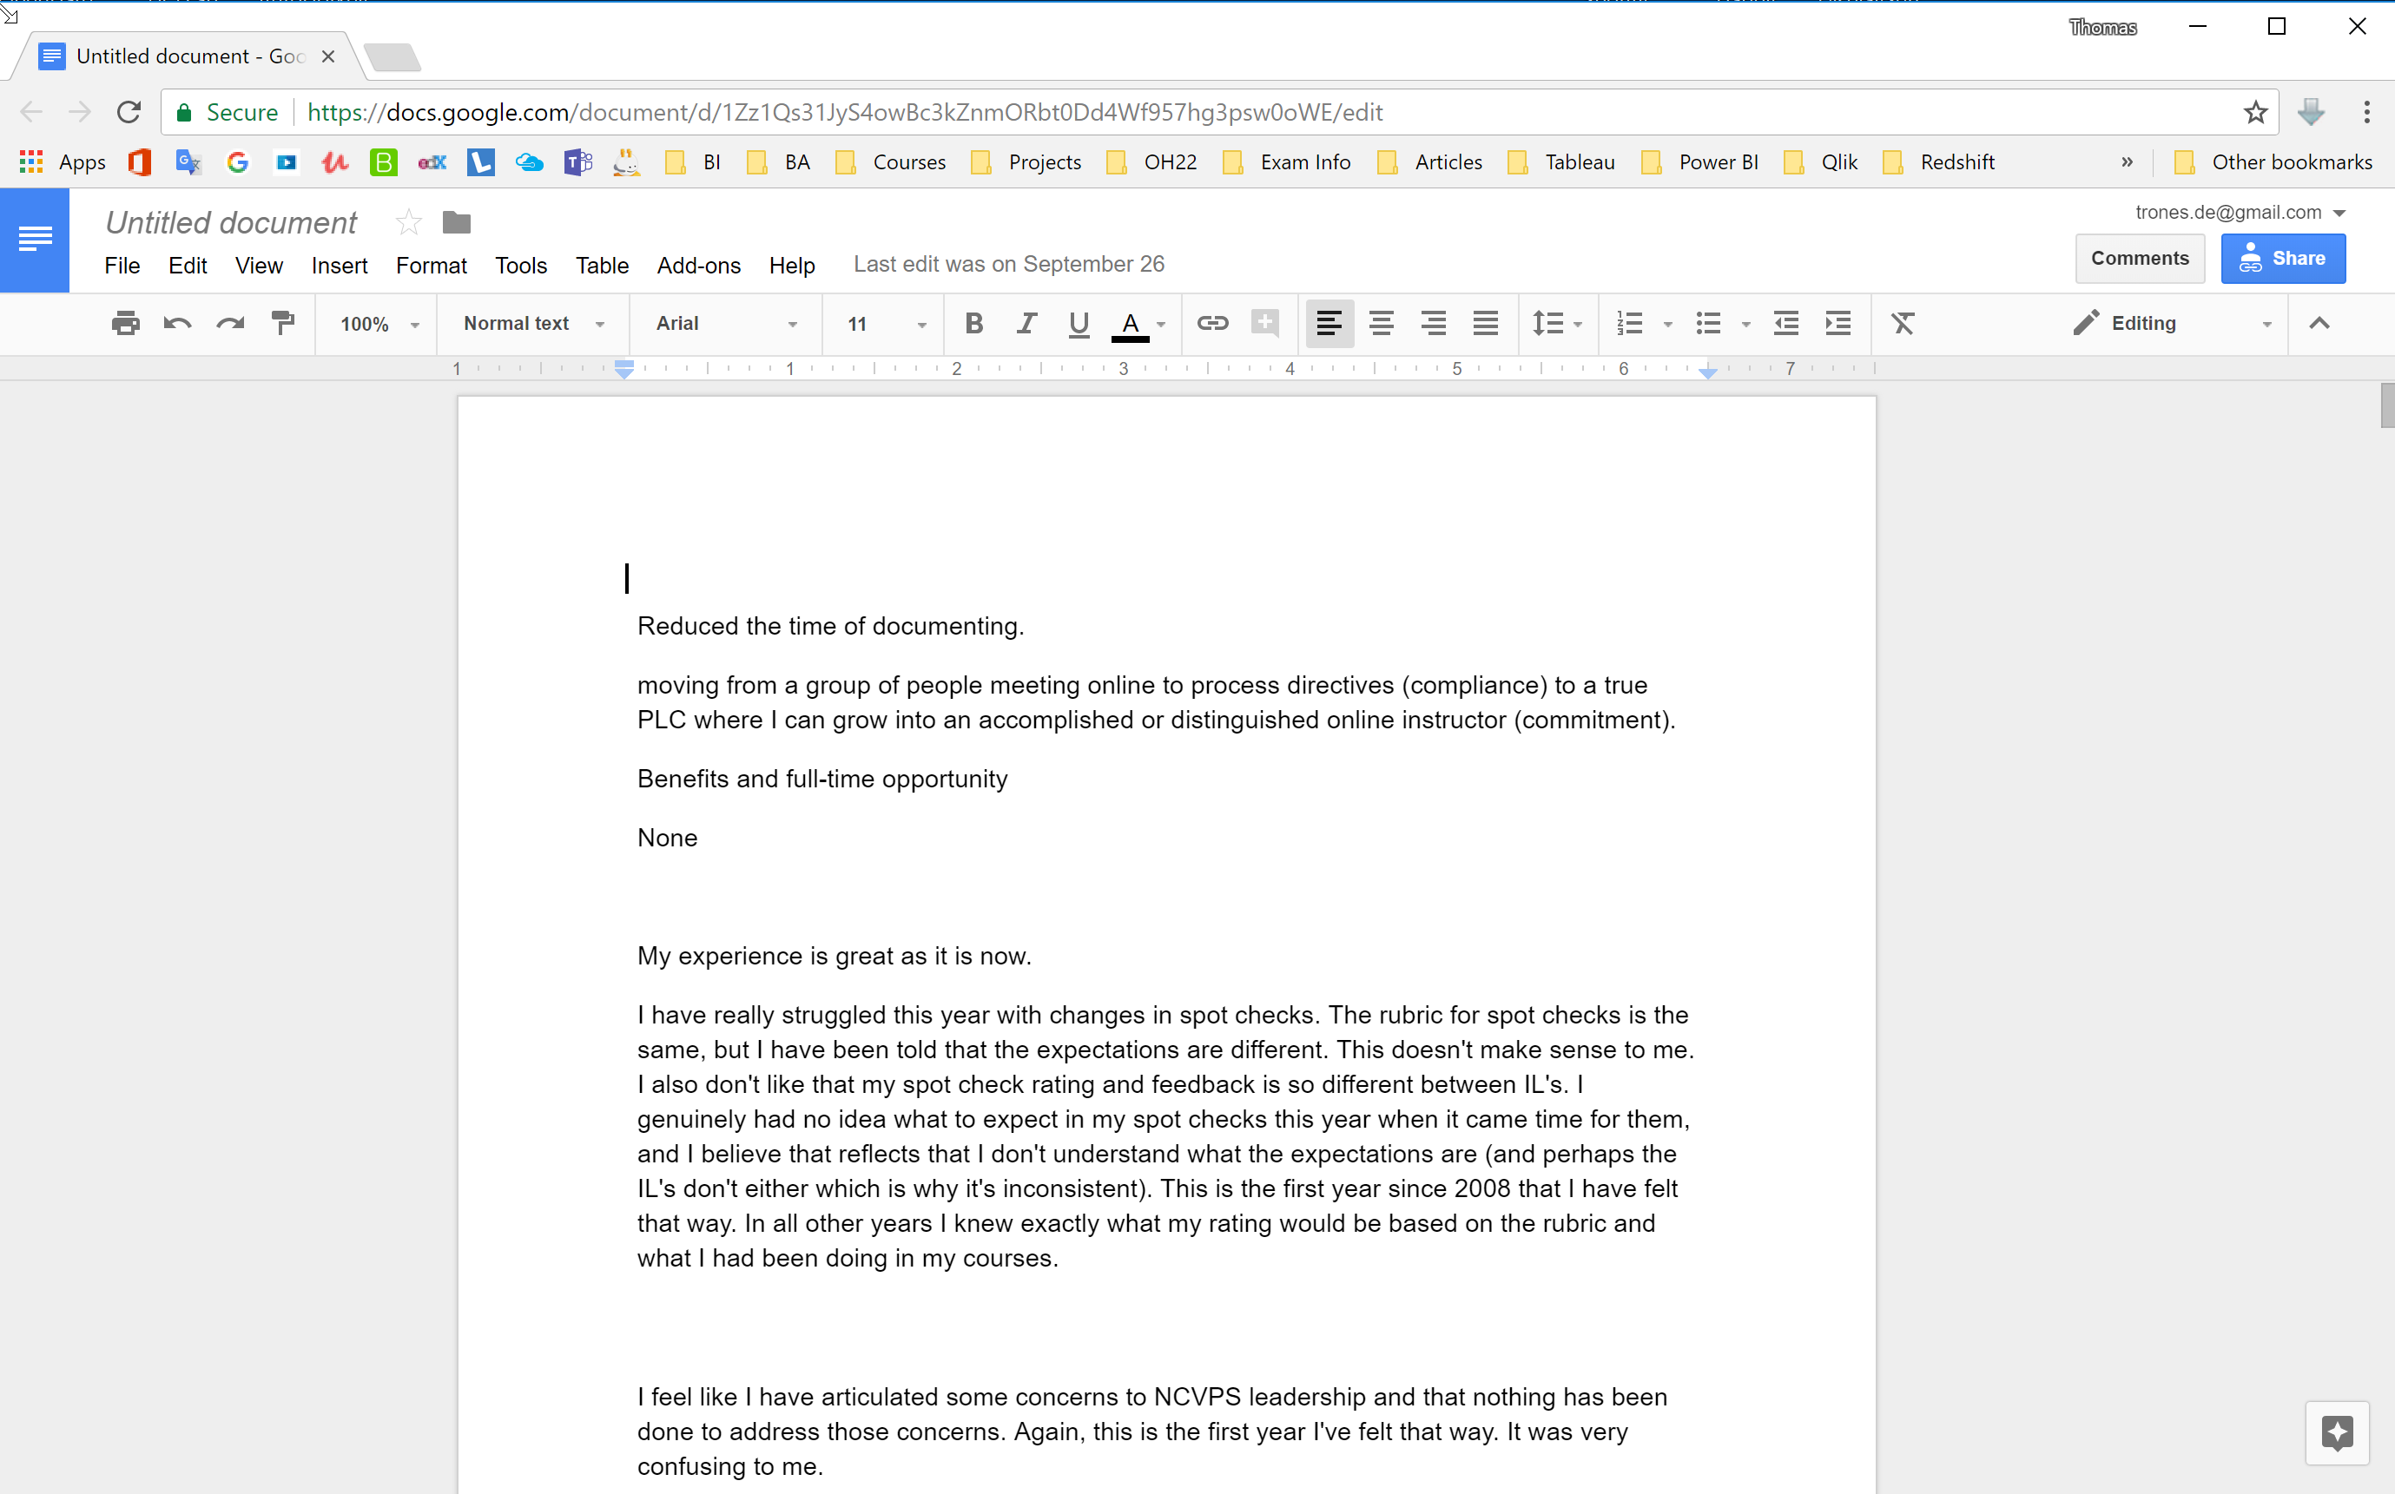

Slide 9
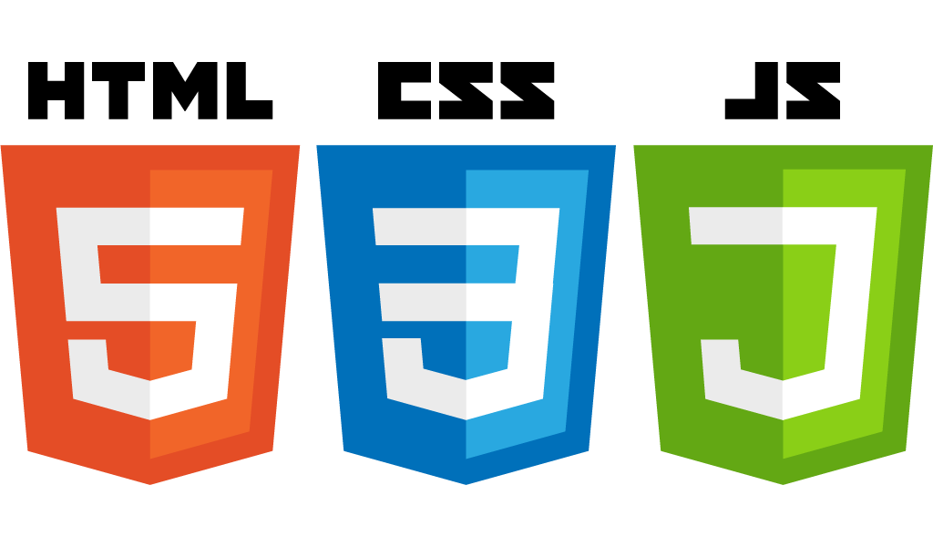

Slide 10
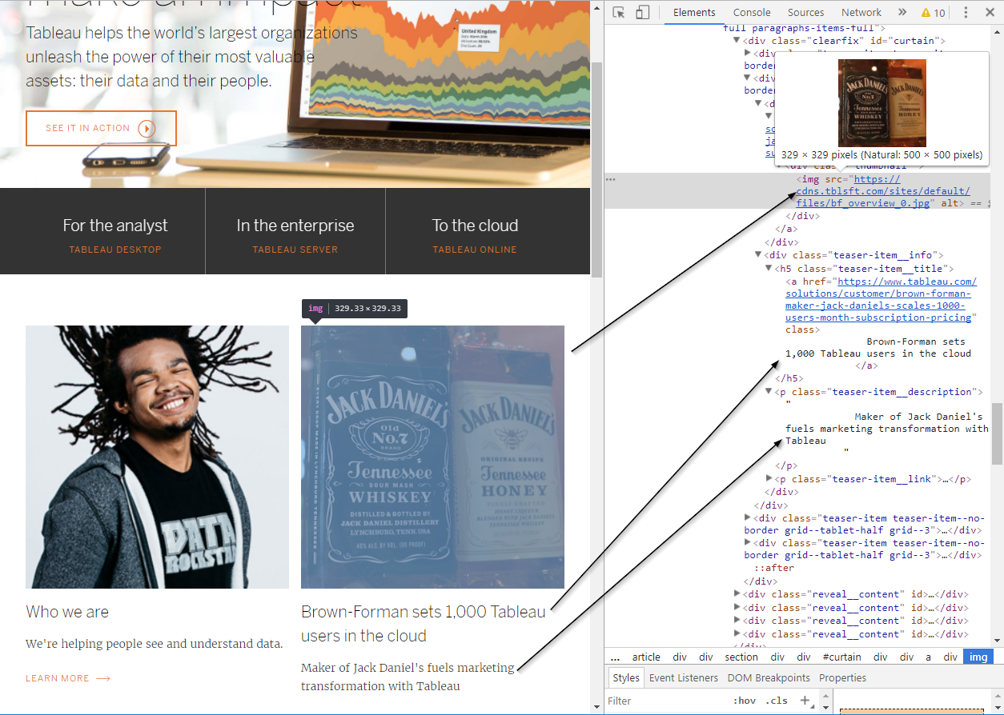

Slide 11
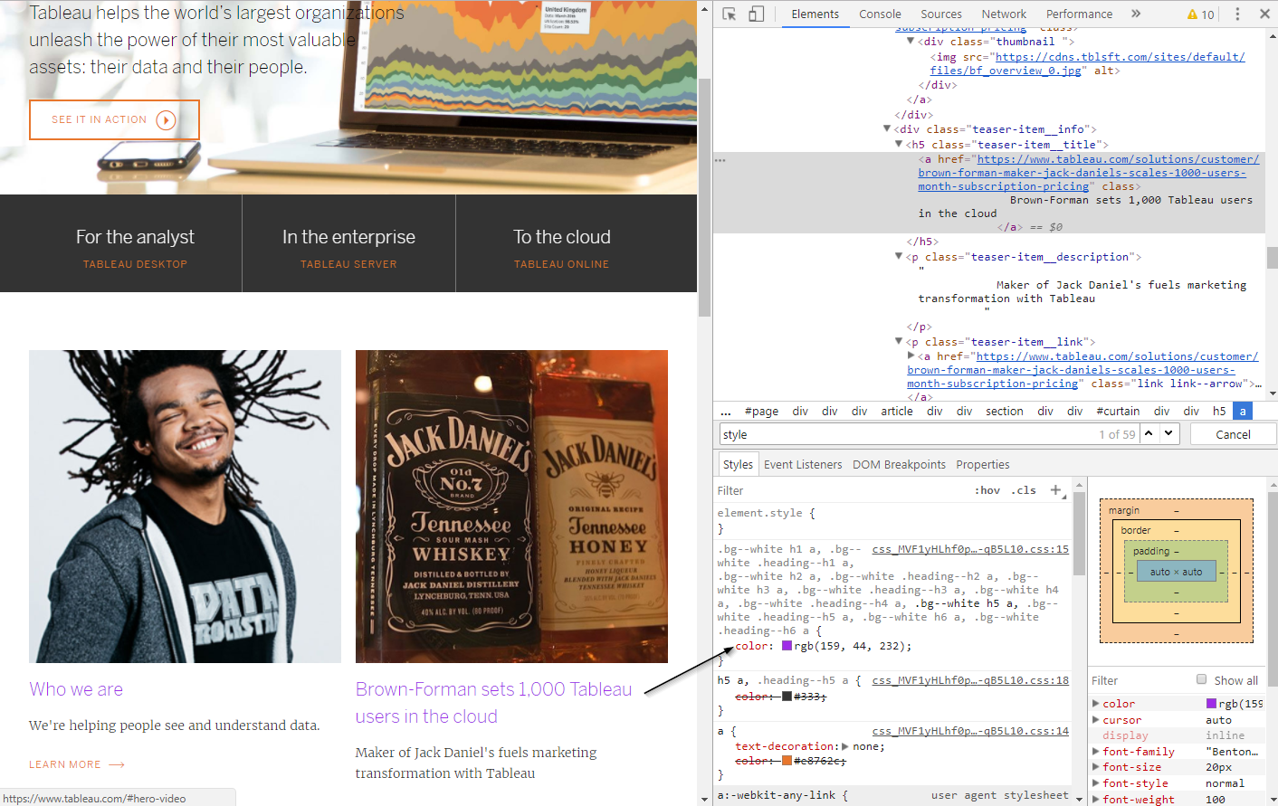

Slide 12
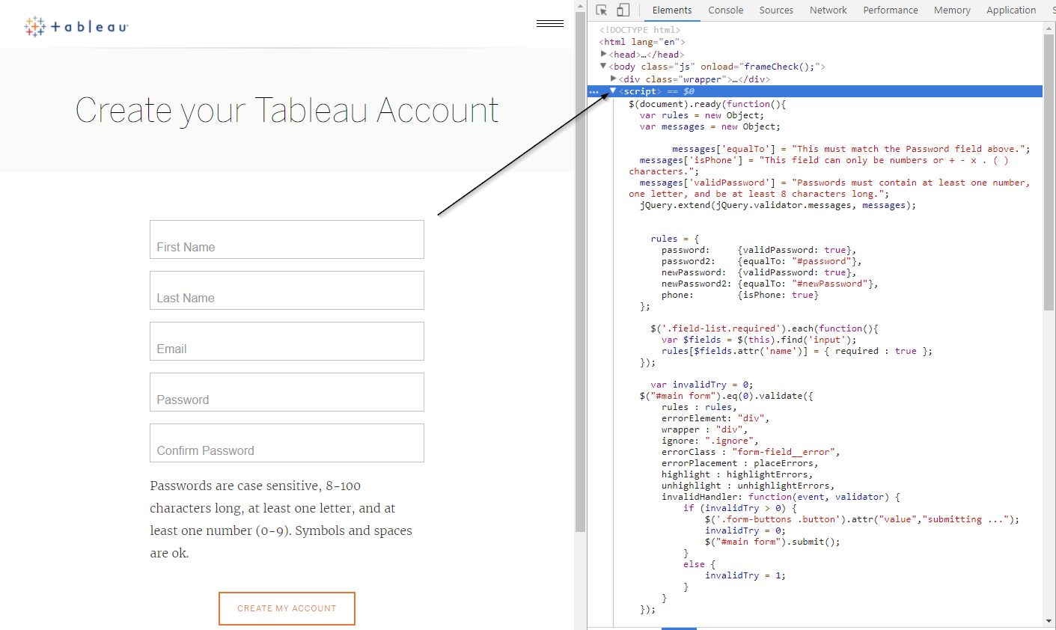

Slide 13
Step 1: 2nd Idea -

Slide 14
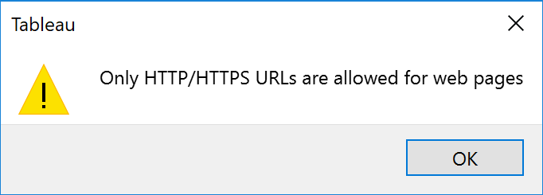
Use a local html file??

Slide 15
Step 1: 3rd Idea-
That localhost thing…

Slide 16
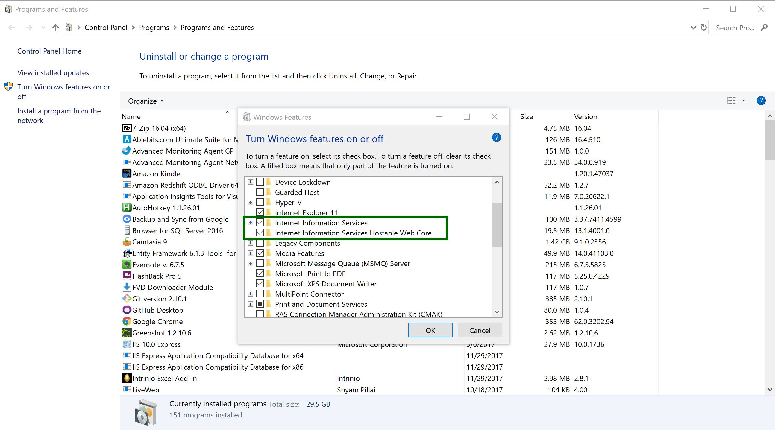

Slide 17
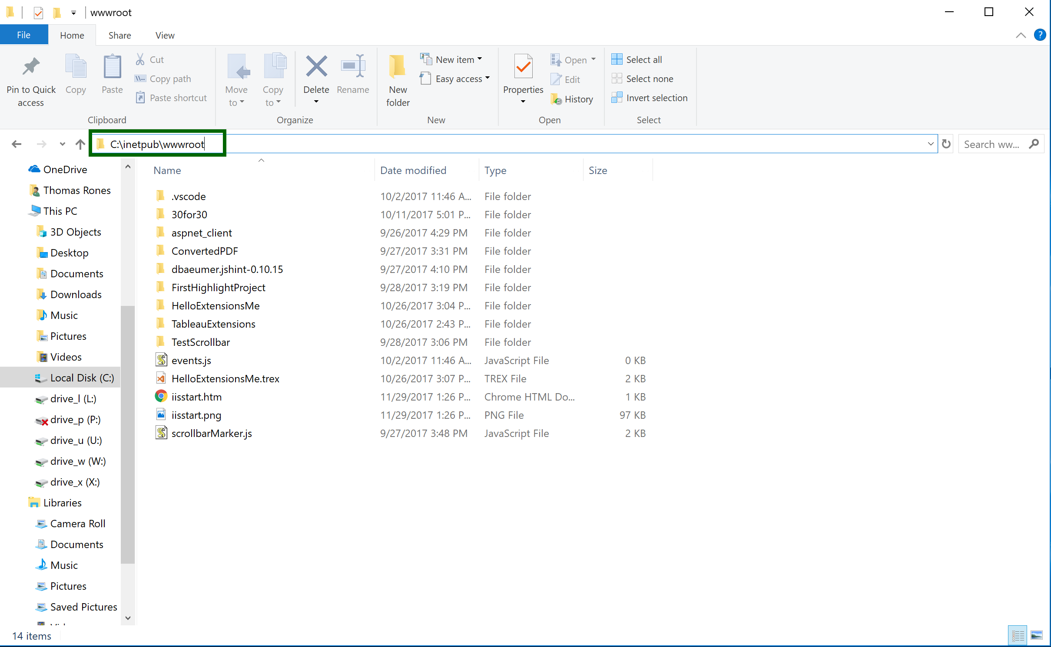

Slide 18
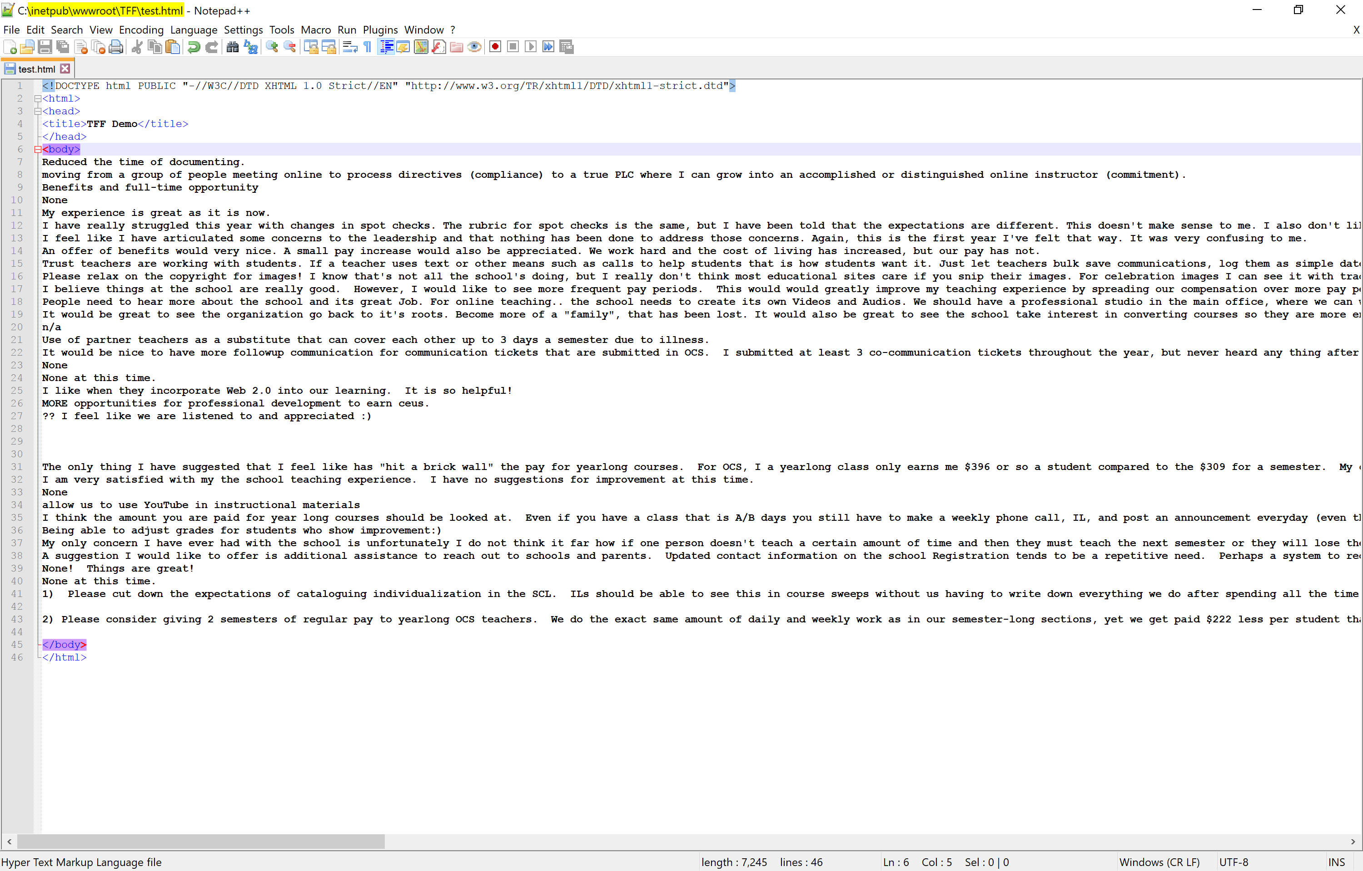

Slide 19
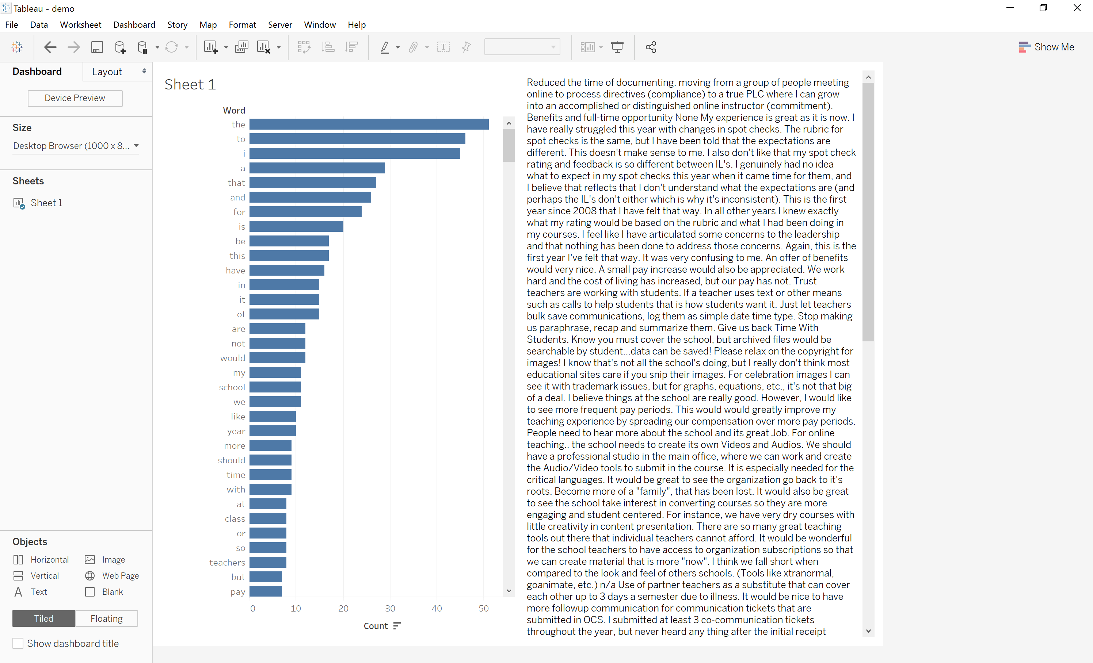

Slide 20
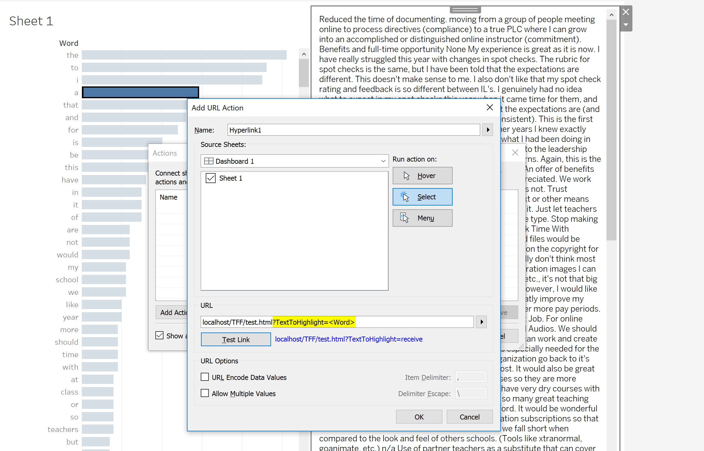

Slide 21
Step 2:
Find (or write) a script to get the URL parameter and pass it to a variable

Slide 22
Demo

Slide 23
Step 3:
Find (or write) a script to highlight the word in the URL parameter

Slide 24
Demo

Slide 25
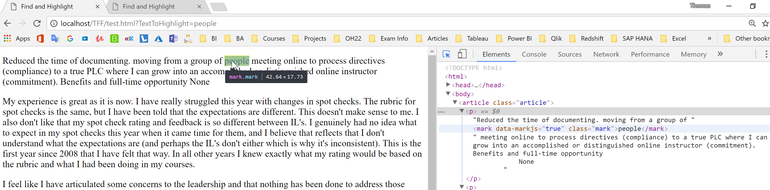

Slide 26
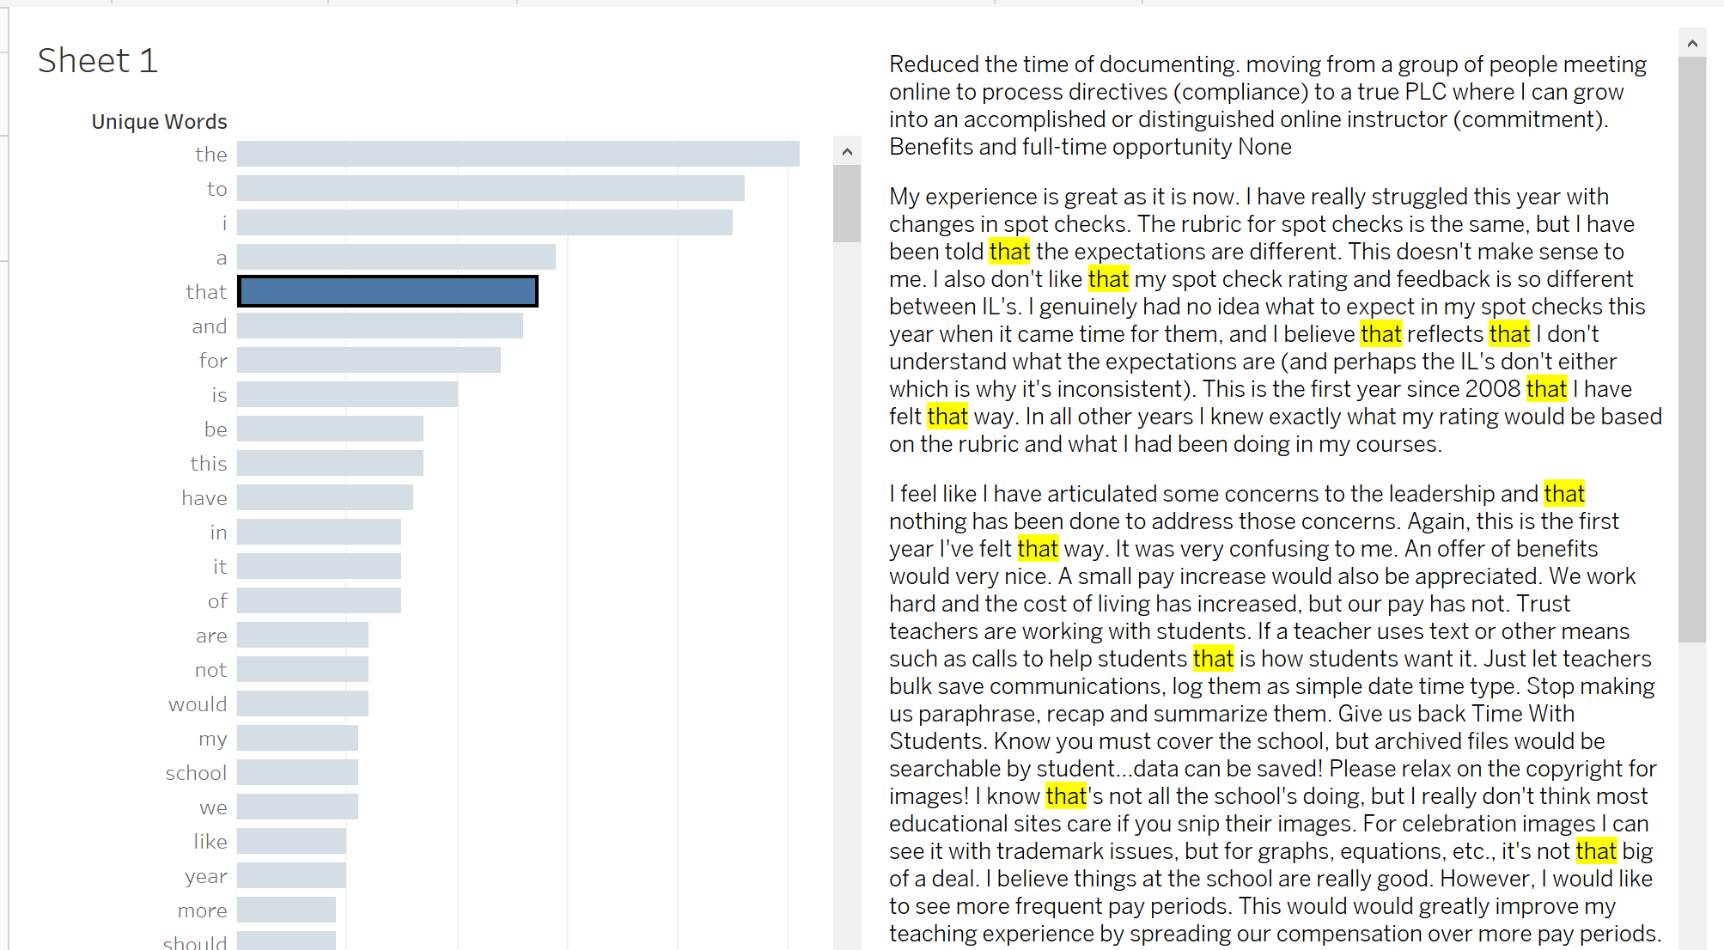

Slide 27
Step 4:
Find (or write) script for the scrollbar

Slide 28
Demo

Slide 29
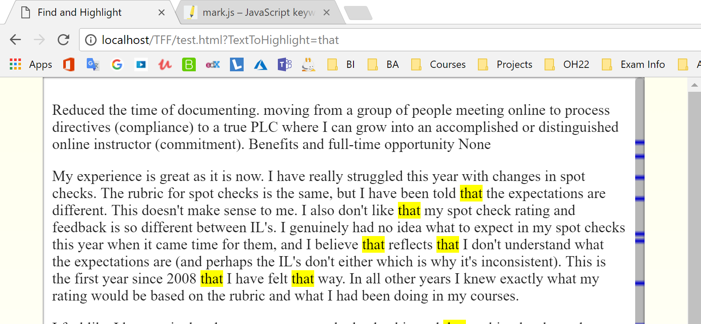

Slide 30
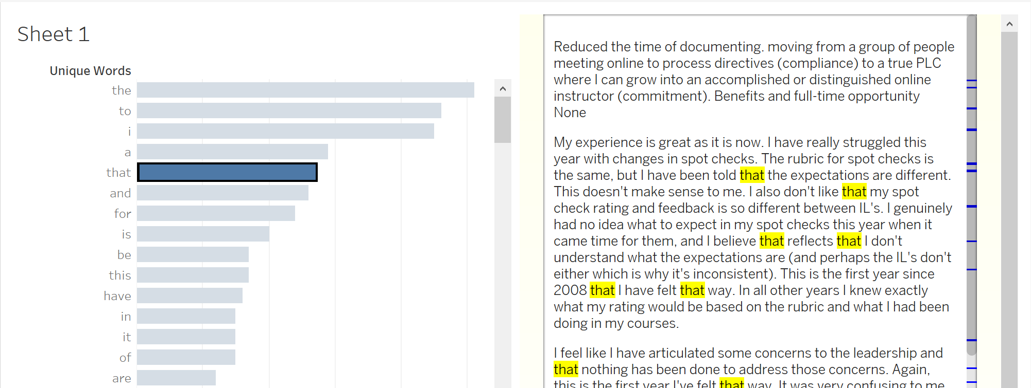

Slide 31
And that’s How Tableau taught me JavaScript

Slide 32
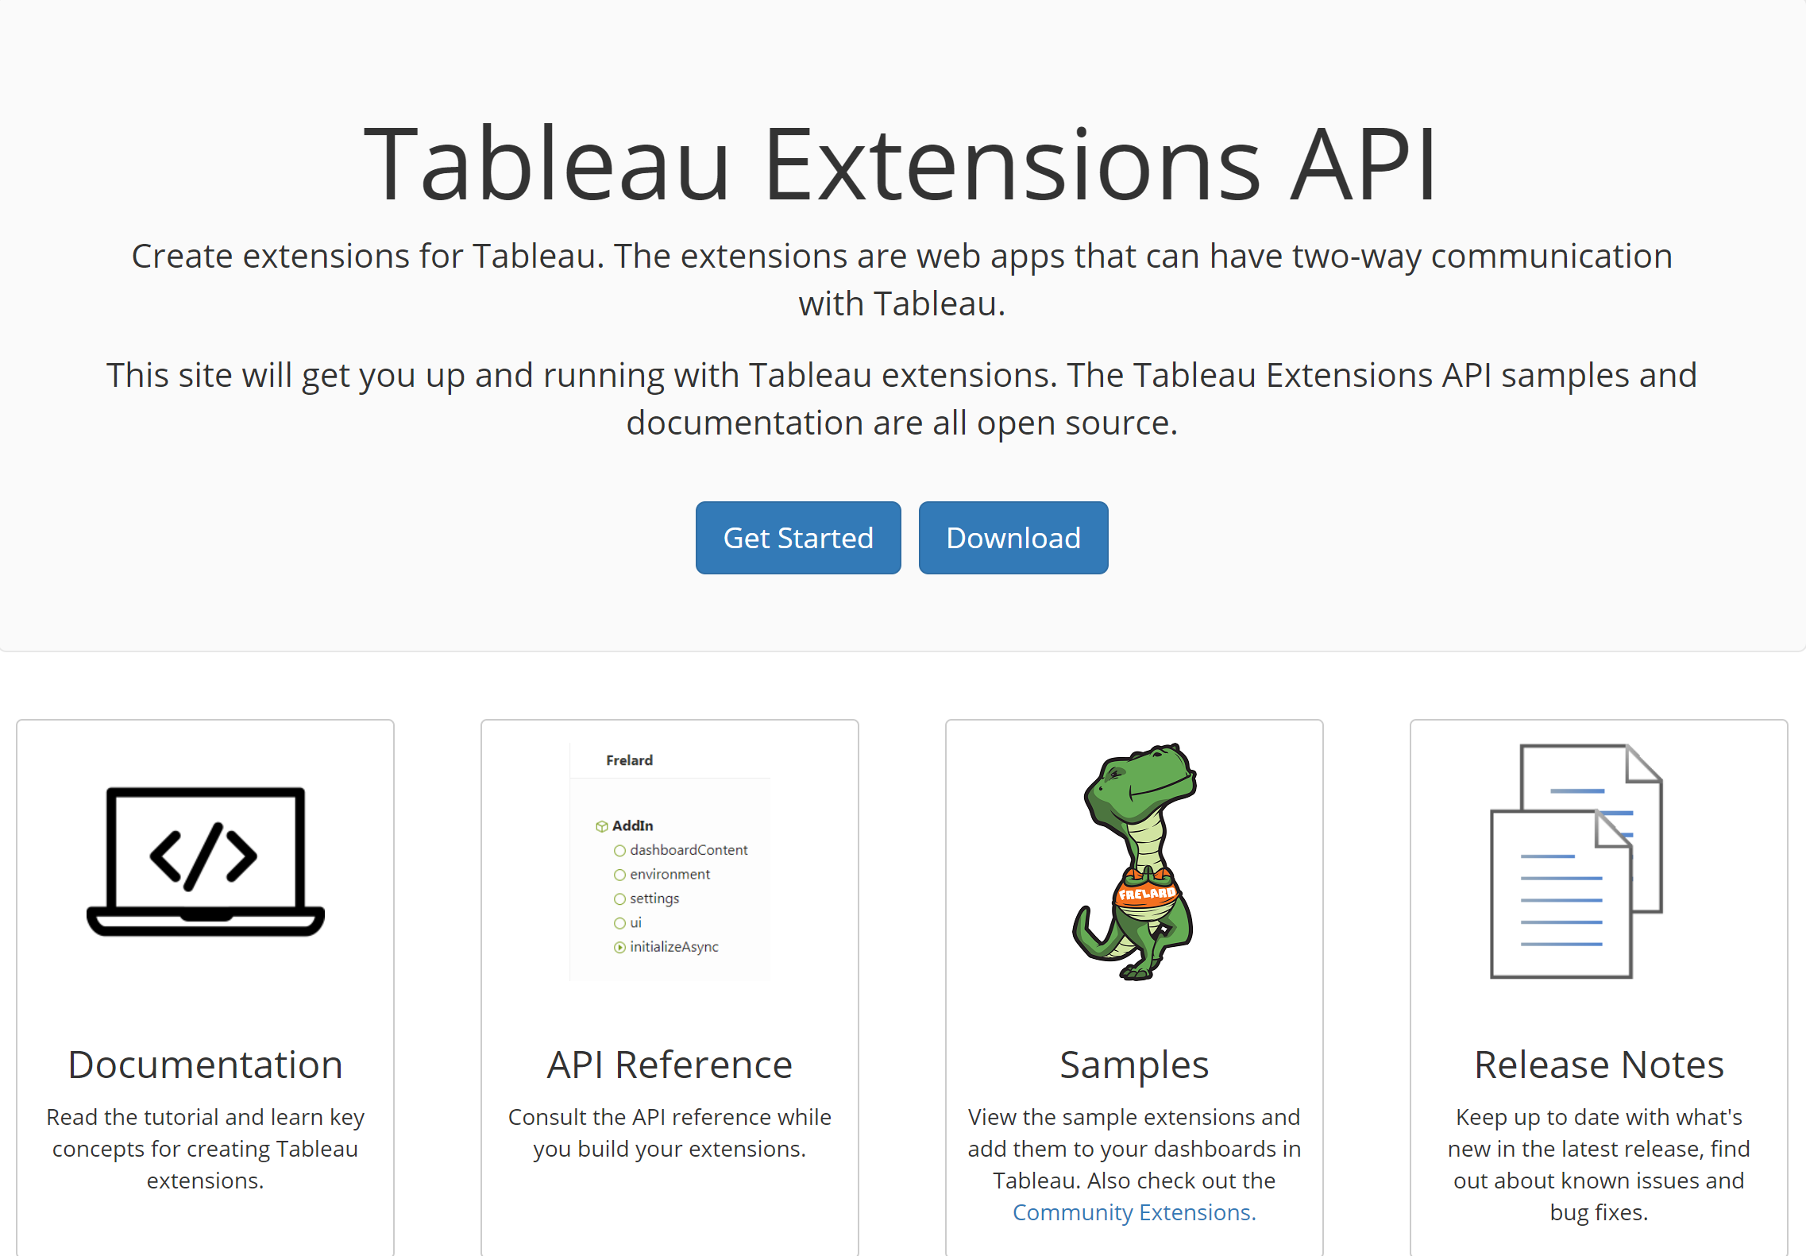
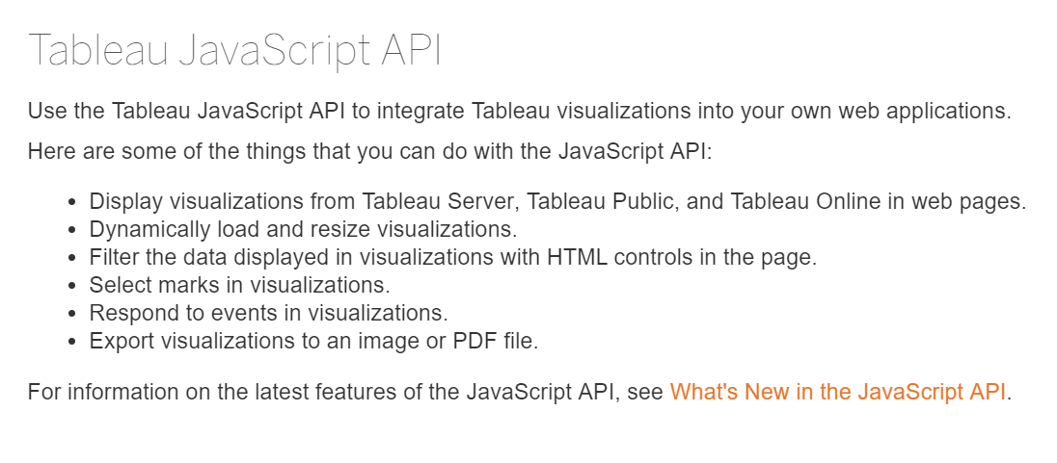
Digging in Deeper…

Slide 33
If you would like to collaborate…
Thomas Rones oh22data AG
@thomasrones trones.de@gmail.com

